Slide 1
All About Me
By: Ashley Colindres

Slide 2

My Family
I have 3 brothers (27,24,19)
Mom and Dad (Luvinda Colindres & Miguel Adon
5 aunts and uncles on my moms side
7 aunts and uncles on my dads side
Only one pair of grandparents are alive (dad side)
And me

Slide 3

My Best Friends
Ashley Messer
Loren Mcclung
Haley Watson
Jori Cook
Vania Pizzano (doesn’t go to this school)
Melanie Loredo
Rachel Puig (doesn’t go to this school either)

Slide 4

My Hobbies
I sometimes write quotes
I go cycling with my dad
I take art classes online
I'm always listening to music 24/7
Cycling is the sport or activity of riding a bicycle.

Slide 5

My favorite movie
A movie that I love is Aquamarine

Slide 6

My Favorite Book
My favorite book is a series called Survivors
The Empty City is a 2012 children's fantasy novel written under the pseudonym Erin Hunter. It is the first in the Survivors novel series.

Slide 7

My favorite singer
My favorite singer is Christina Perri

Slide 8

My favorite song
My favorite song is Jar of Hearts by Christina Perri

Slide 9

Where I grew up
I was born in Glencoe, Minnesota
And I moved here when I was 8
GSL was where I went to school in Minnesota.

Slide 10

Favorite Place to Shop
Eastchase Mall
Birmingham Mall
& Eastdale Mall

Slide 11

My favorite restaurant
My favorite restaurant is Texas Roadhouse
I love it because of their ribs and steak (yum)

Slide 12
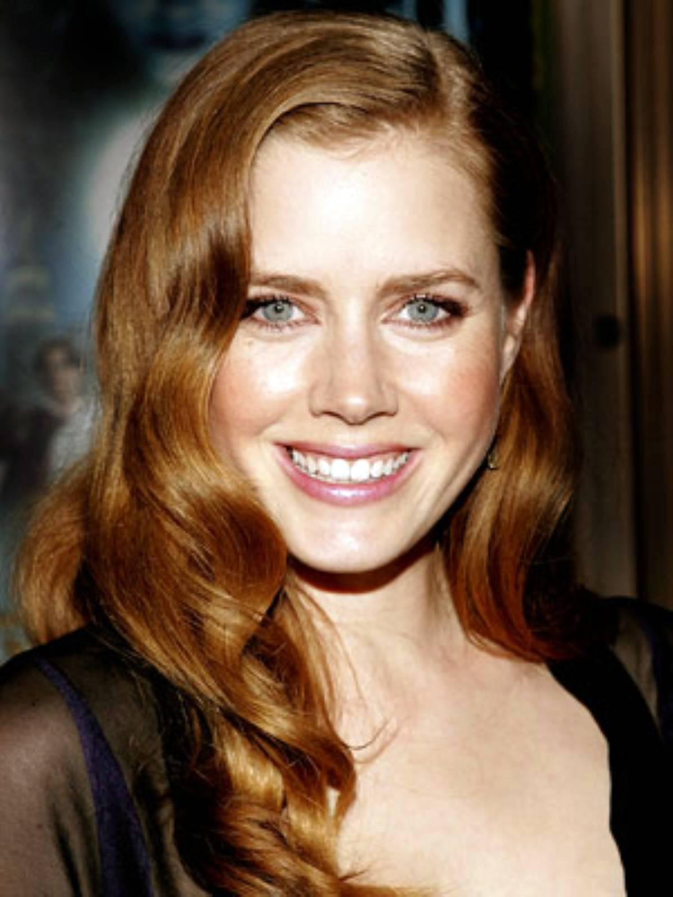
Favorite Actress
My favorite actress is Amy Adams
I love all her movies

Slide 13

Favorite Food
My favorite food is my moms food
Lasagna
Grilled Meat (carne asada)
Her steak with rice

Slide 14

Future Career
I'm planning to be a singer
Have a music career
Play music
Write music (etc.)

Slide 15

Favorite Album
My favorite album is Night Visions by Imagine Dragons

Slide 16

Favorite Group
Favorite group is Imagine Dragons
My favorite song of them is Demons and Radioactive

Slide 17


My favorite basketball team
The Minnesota Timberwolves and the Los Angeles Lakers

Slide 18

Favorite Places to go Visit
Universal Studios
Beaches
Times Square
Niagara Falls
Statue of Liberty

Slide 19

My favorite Subject
My favorite subject is science
My teacher is Mrs. Owens (life science)
Forensic Teacher is Mrs. House

Slide 20

My “Used” to have Pets
I had 2 pets
Both were golden retrievers
One named Brownie
The other one Sugar
& Sugar was the small one

Slide 21
The End

